Slide 1

Created By:

Slide 2
Brainstorming and Thought Process
Original Ideas
Chosen Project
AI Chat Bot for mental health
We decided to create an app that assists people who have been diagnosed with OCD in their everyday life. As OCD is commonly an overlooked issue, there aren’t many services that provide 24/7 support at a low price.
App for easier volunteer
services
App for women with safer transportation options

Slide 3
What is OCD?
Also known as Obsessive-Compulsive Disorder, OCD is a mental disorder that is characterized by repetitive actions or thoughts that may seem impossible to stop.
Types of OCD
Contamination
Ruminations
Intrusive Thoughts
Checking
- Hoarding
Common Symptoms
Fear of contamination or dirt
Needing things orderly or symmetric
Obsessive compulsions such as washing hands, counting, or routine
- Intense stress when things aren’t a certain way

Slide 4
OCDOTs Purpose
OCD Assistance
Easy Therapy Access
01
02
Emergency Access
Overall Support
03
04
Provides help and notifications when the user is experiencing OCD symptoms or attacks
Provides 1 free therapy session a month along with the ability to purchase a premium subscription for cheaper therapy access
Immediate access to OCD hotlines in case of an emergency
With the use of an implemented AI Chat Box, the user can get feedback, statistics, and advice with any of their needs

Slide 5




App Features
Profile
Therapy
Progress
Ability to create and personalize your own profile based on diagnosis, symptoms, etc.
Allows the user to select between different types of therapy such as group, individual, or an OCD evaluation
Keeps track of OCD diagnosis improvements based on statistics and therapy sessions
Statistics
Provides the user with personalized statistics about their OCD habits based off Apple Watch health data

Slide 6

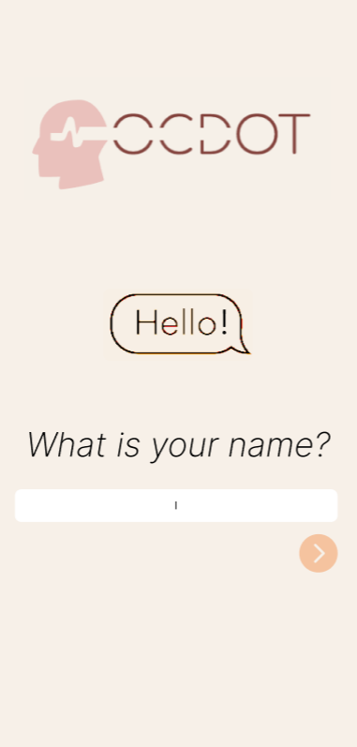
What Was Used
App Design:
Figma
Code:
HTML
JavaScript
- CSS

Slide 7
Revenue & Originality
Main Sources of Revenue
Advertisements
With the free app version there will be sponsored ads within the app to gain money for further advancements
Premium Therapy Subscriptions
Although users get 1 free therapy session a month, there is an option to purchase a premium therapy plan for $8.99 a month that removes ads and provides more therapy options
Originality
Common OCD Apps
NOCD and OCD.app
Improvements
What makes OCDOT different from other OCD apps is the significant price difference along with the ability to receive accurate statistics and updates on compulsive habits. No other OCD app can detect when and how often a habit is being done without direct user input.

Slide 8
Demonstration

